Slide 1
View
Presenter
Database
This layer is called “Model”. I would rather call it “business logic”
User

Slide 2
View
Presenter
Model

Slide 3
View
5) Presenter invokes
view.showUsers(userList)
to make the view display the list of users
1) User clicks on “load button”. View invokes
presenter.loadUsers()
2) Presenter invokes
view.showLoading()
Presenter
3) Presenter invokes
database.getUsers()
which runs async. Presenter implements a callback to get notified when data is loaded
4) Database query (async) has finished. Callback will be invoked to pass the queried list of Users back to the presenter
Database

Slide 4
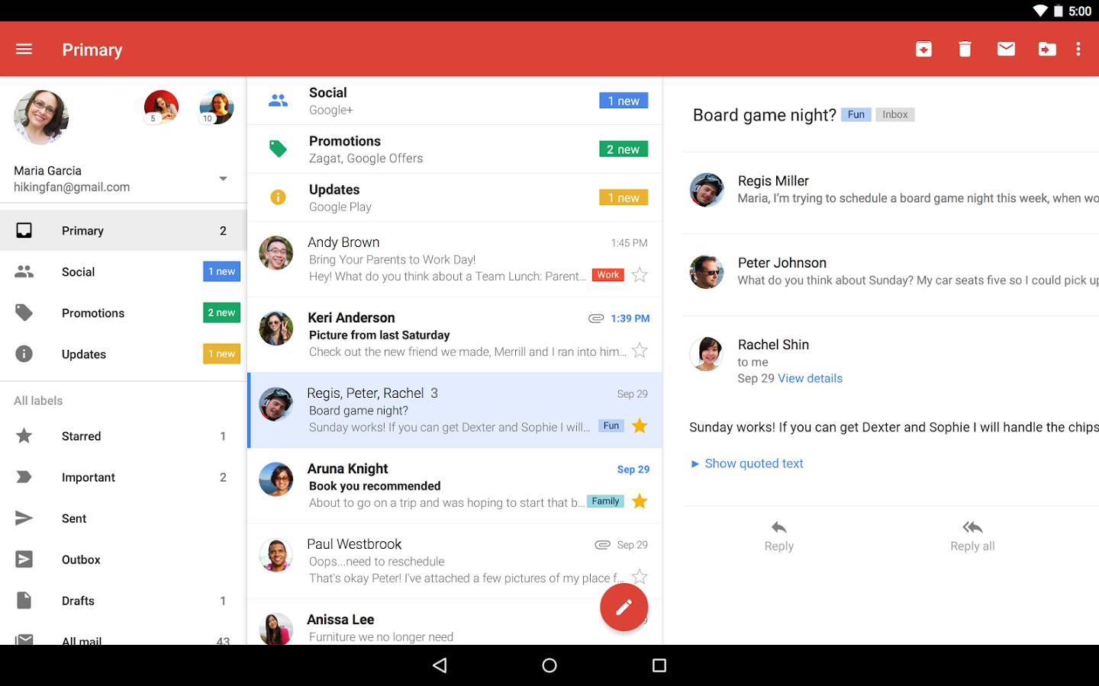
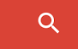

David

Slide 5
SearchEngine
SearchPresenter
SearchView
David
AccountView
InboxView
MailView
AccountPresenter
InboxPresenter
MailPresenter
AccountManager
MailProvider

Slide 6
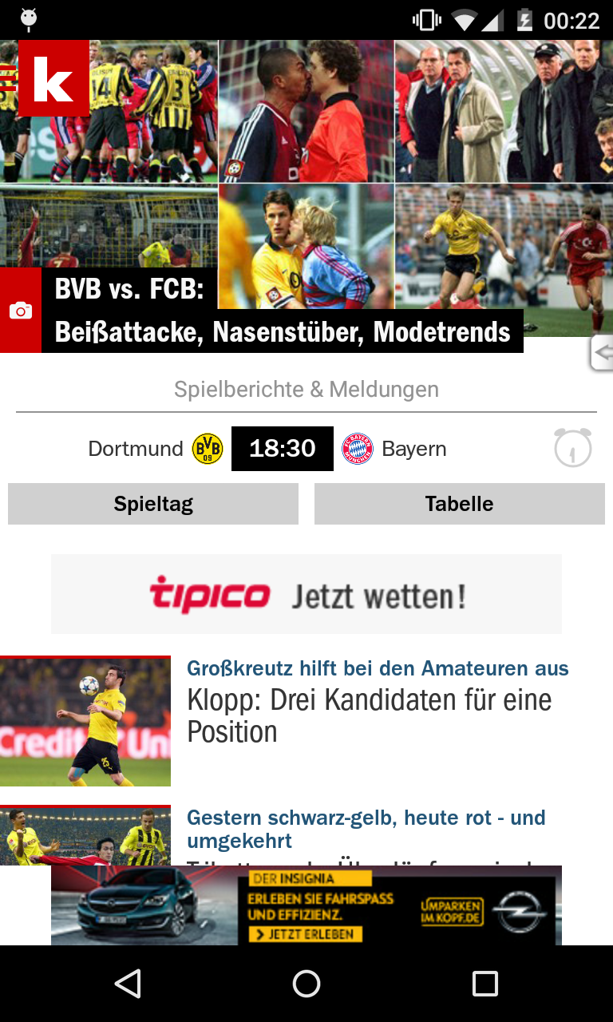
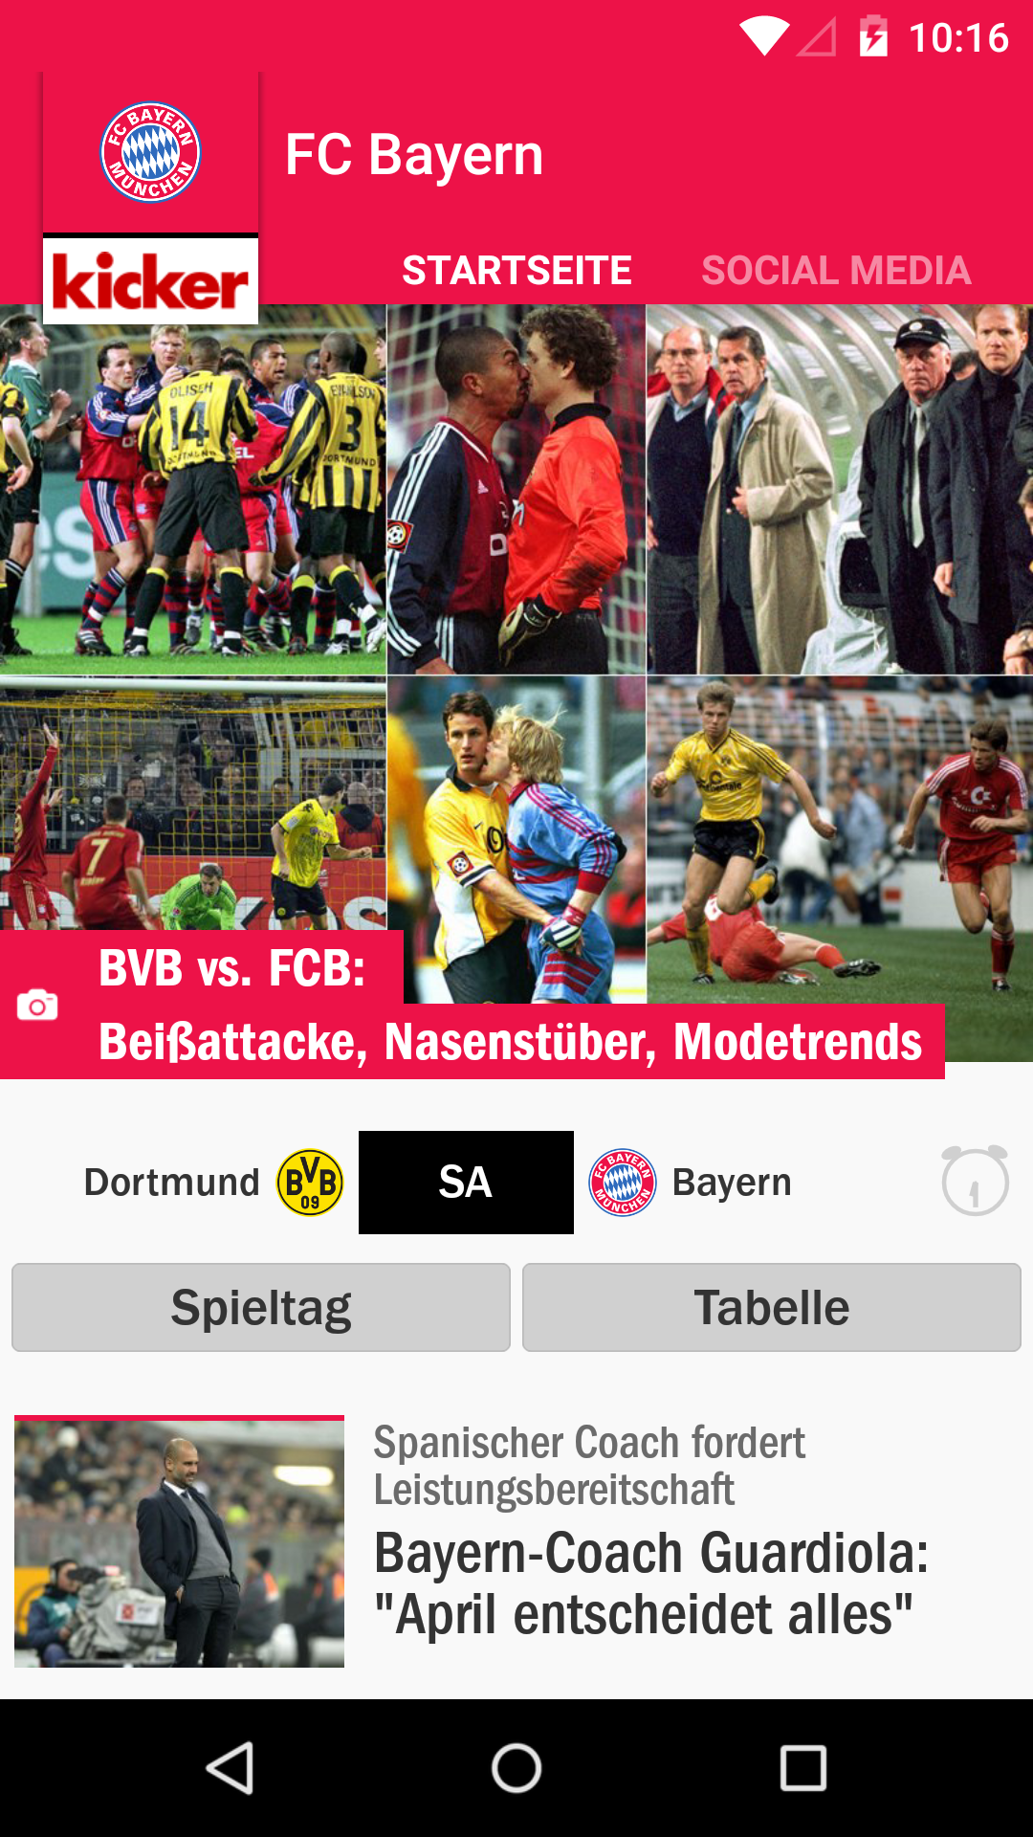

Slide 7
onCreate() Butterknife.inject() Icepick.restore()
createPresenter()
presenter.attachView()
1.
4.
Invoked if onNewViewStateInstance() OR
if viewState was “showLoading“
3. a)
2.
onPostCreate() createOrRestoreViewState()
onNewViewStateInstance()
or
3. b)
onViewStateInstanceRestored()
loadData()
Activity is running
5.
6.
onSaveInstanceState() saveViewState()
7.
onDestroy() presenter.detachView()

Slide 8
onCreate() FragmentArgs.inject() Icepick.restore()
1.
2.
onCreateView() getLayoutRes()
6.
onViewCreated() Butterknife.inject()
createPresenter()
Creates presenter only
if presenter == null
Invoked if onNewViewStateInstance() OR
if viewState was “showLoading“
NOT invoked if setRetainInstanceState(true)
3.
5. a)
4.
onActivityCreated() createOrRestoreViewState()
onNewViewStateInstance()
or
5. b)
setRetainInstanceState(true)
loadData()
onViewStateInstanceRestored()
Fragment is running
7.
onSaveInstanceState() saveViewState()
8.
9.
onDestroyView()
presenter.detachView()
10.
onDestroy()

Slide 9
UI
i.e. ListView, UITableVIew
I call this layer VIEW.
It consists of two sub-layers: 1) UI (User Interface) Components
2) Controller
Controller i.e Fragment, UIViewController
Presenter
Database
This layer is called MODEL. I would rather call it “business logic”
User

Slide 10
LoginPresenter
1. Fire LoginSuccessfulEvent
EventBus
2. Deliver LoginSuccessfulEvent
3. Reload data
MenuPresenter
MailsPresenter
3. Reload data
4. Update View
MenuView
MailsView

Slide 11
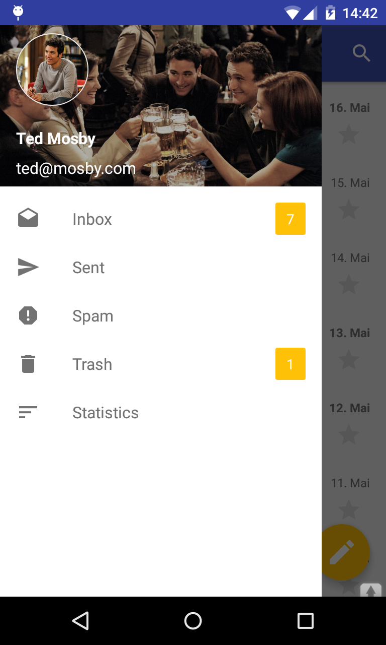
AccountView
AccountManager
AccountPresenter
MenuView
MailProvider
MenuPresenter

Slide 12
UserView
UserView
UserAdapter
UserPresenter
Rest API
List<User>

Slide 13
UserView
UserView
UserAdapter
PresentationModelTransformer
UserPresenter
Rest API
List<User>

Slide 14
UserView
UserView
UserAdapter
UserPresenter
PresentationModelTransformer
Rest API
List<User>

Slide 15
I need base class for my view
No, I display static data
Presenter?
Yes, View changes
its state dynamically
Yes, view should retain its state
Fragment
AppCompatActivity
No
orientation changes?
No
Loading-Content-Error?
Yes
No
Loading-Content-Error?
Yes
No
third party framework?
Yes
MvpLceFragment
MvpLceActivit
No
third party framework?
Yes
MvpViewStateLceFragment
MvpViewStateLceActivit
MvpFragment
MvpActivit
MvpFrameLayout
FragmentMvpDelegate
ActivityMvpDelegate
ViewGroupMvpDelegate
MvpViewStateFragment
MvpViewStateActivit
MvpViewStateFrameLayout
FragmentMvpViewStateDelegate
ActivityMvpViewStateDelegate
ViewGroupMvpViewStateDelegate

Slide 16
M

